Slide 1
2 many engineers

Slide 2
What is it?
Charity browser add-on – making it easy to donate to charity – “shop and donate”
Summary:
If there is a better price found
Would donate a % to get the saving?
Select your charity of choice
Leader board
See what you have donated and people you have recommended have donated

Slide 3
Value of the hack
1.5 billion online shoppers in 2017.
2.3 trillion dollars spent.
On average $1,437.5 per person*
CONSERVATIVELY Take just 10% of that = $143 dollars per year for charity
X 1.5 billion?......
$228,800,000,000 BILLION EACH YEAR FOR CHARITY.*

Slide 4
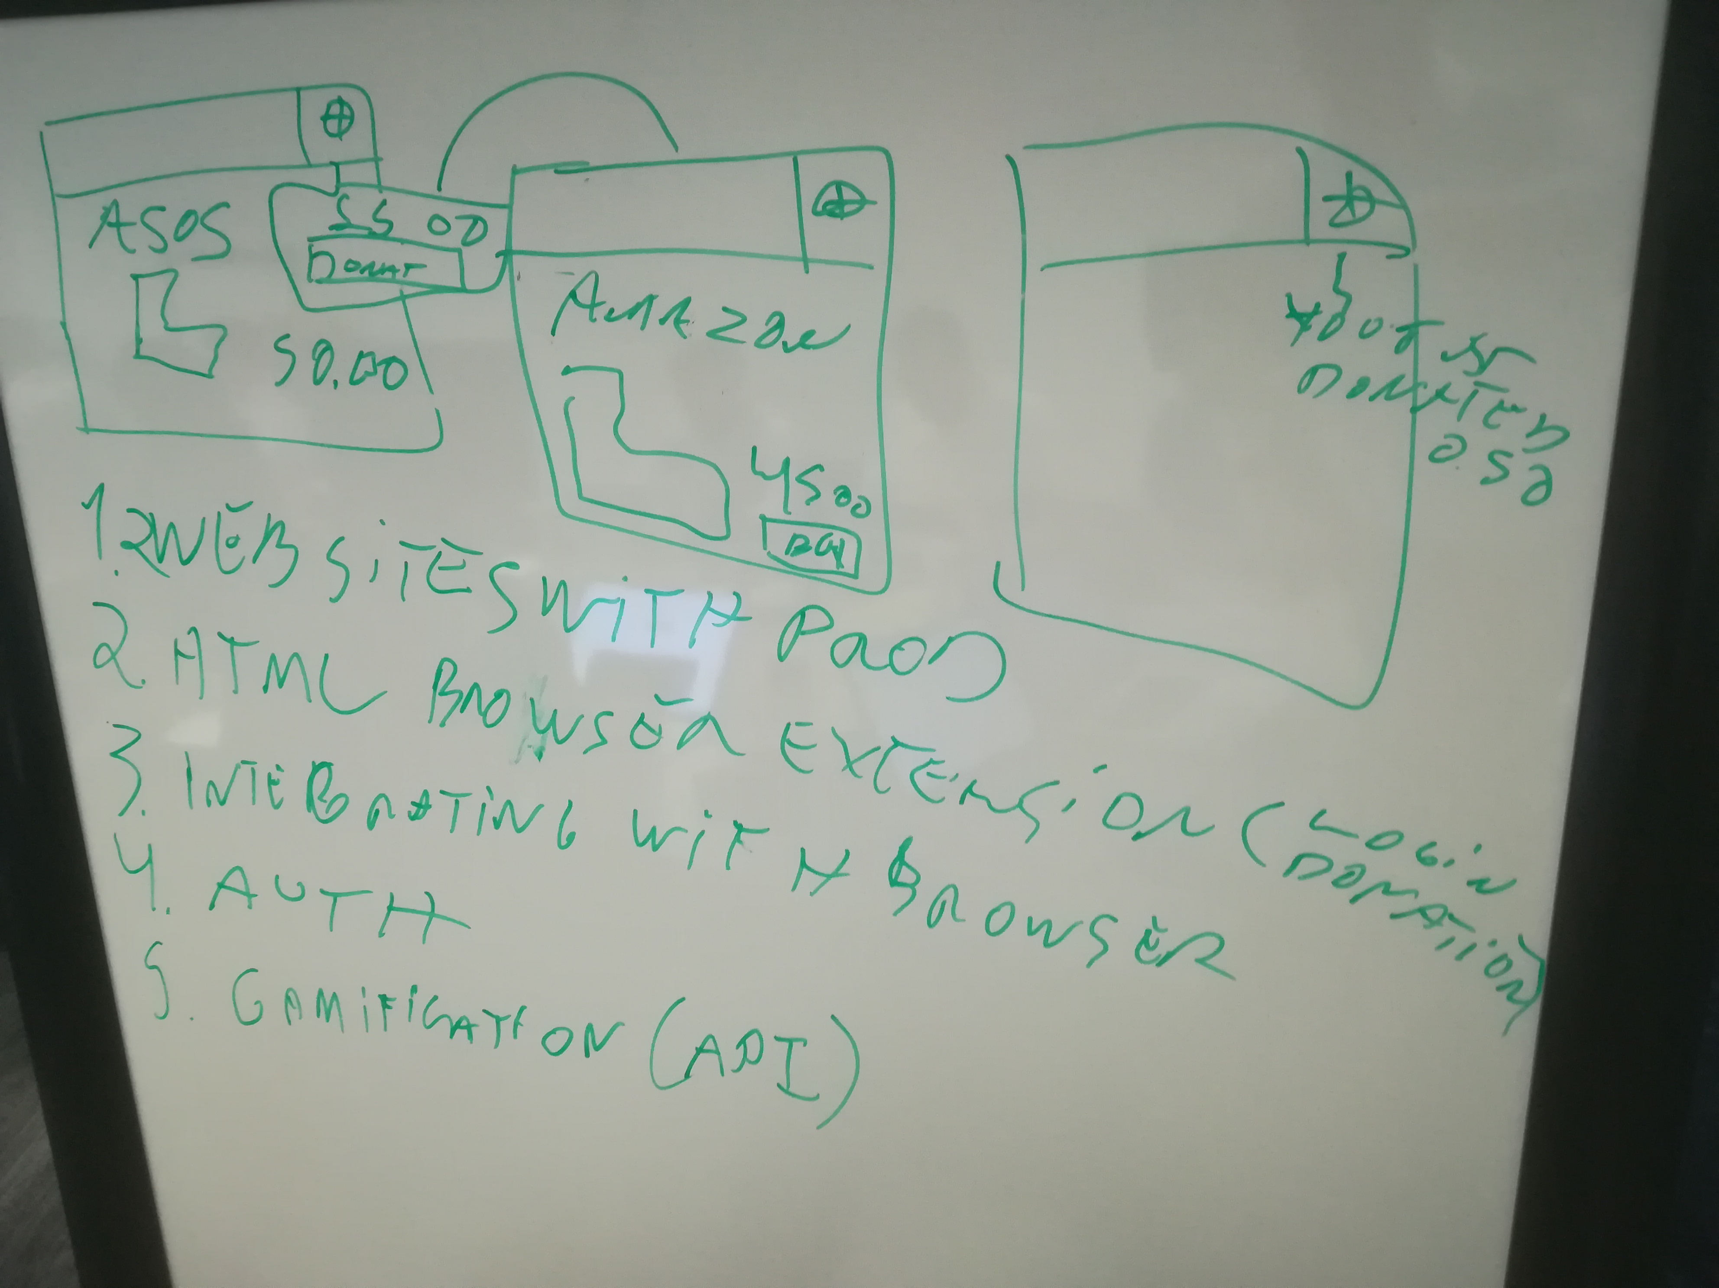
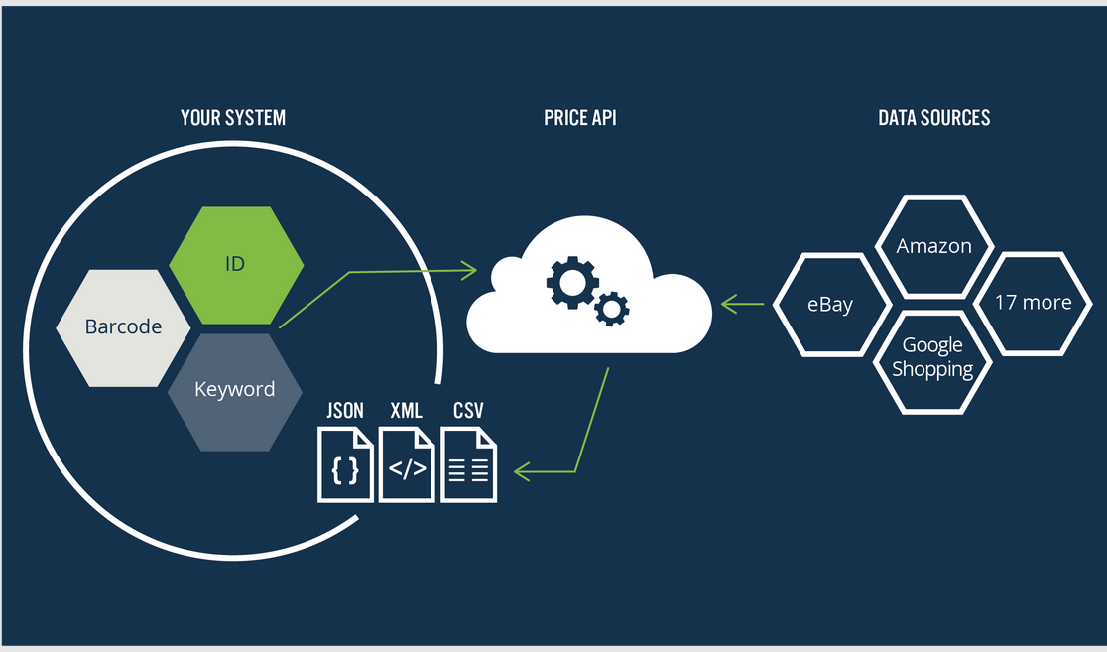
Design
We started with this

Slide 5
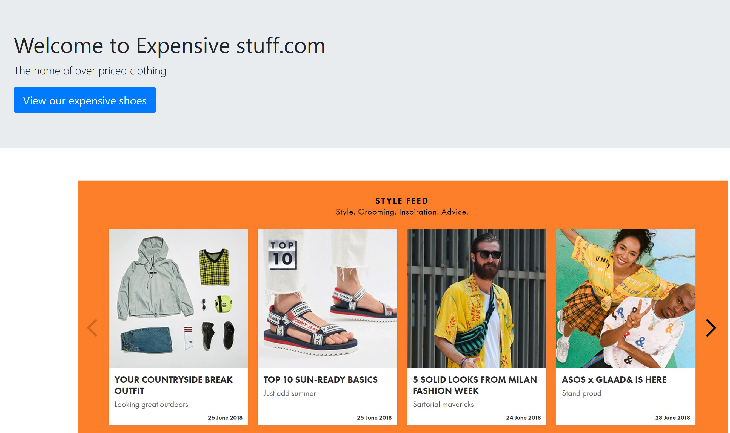
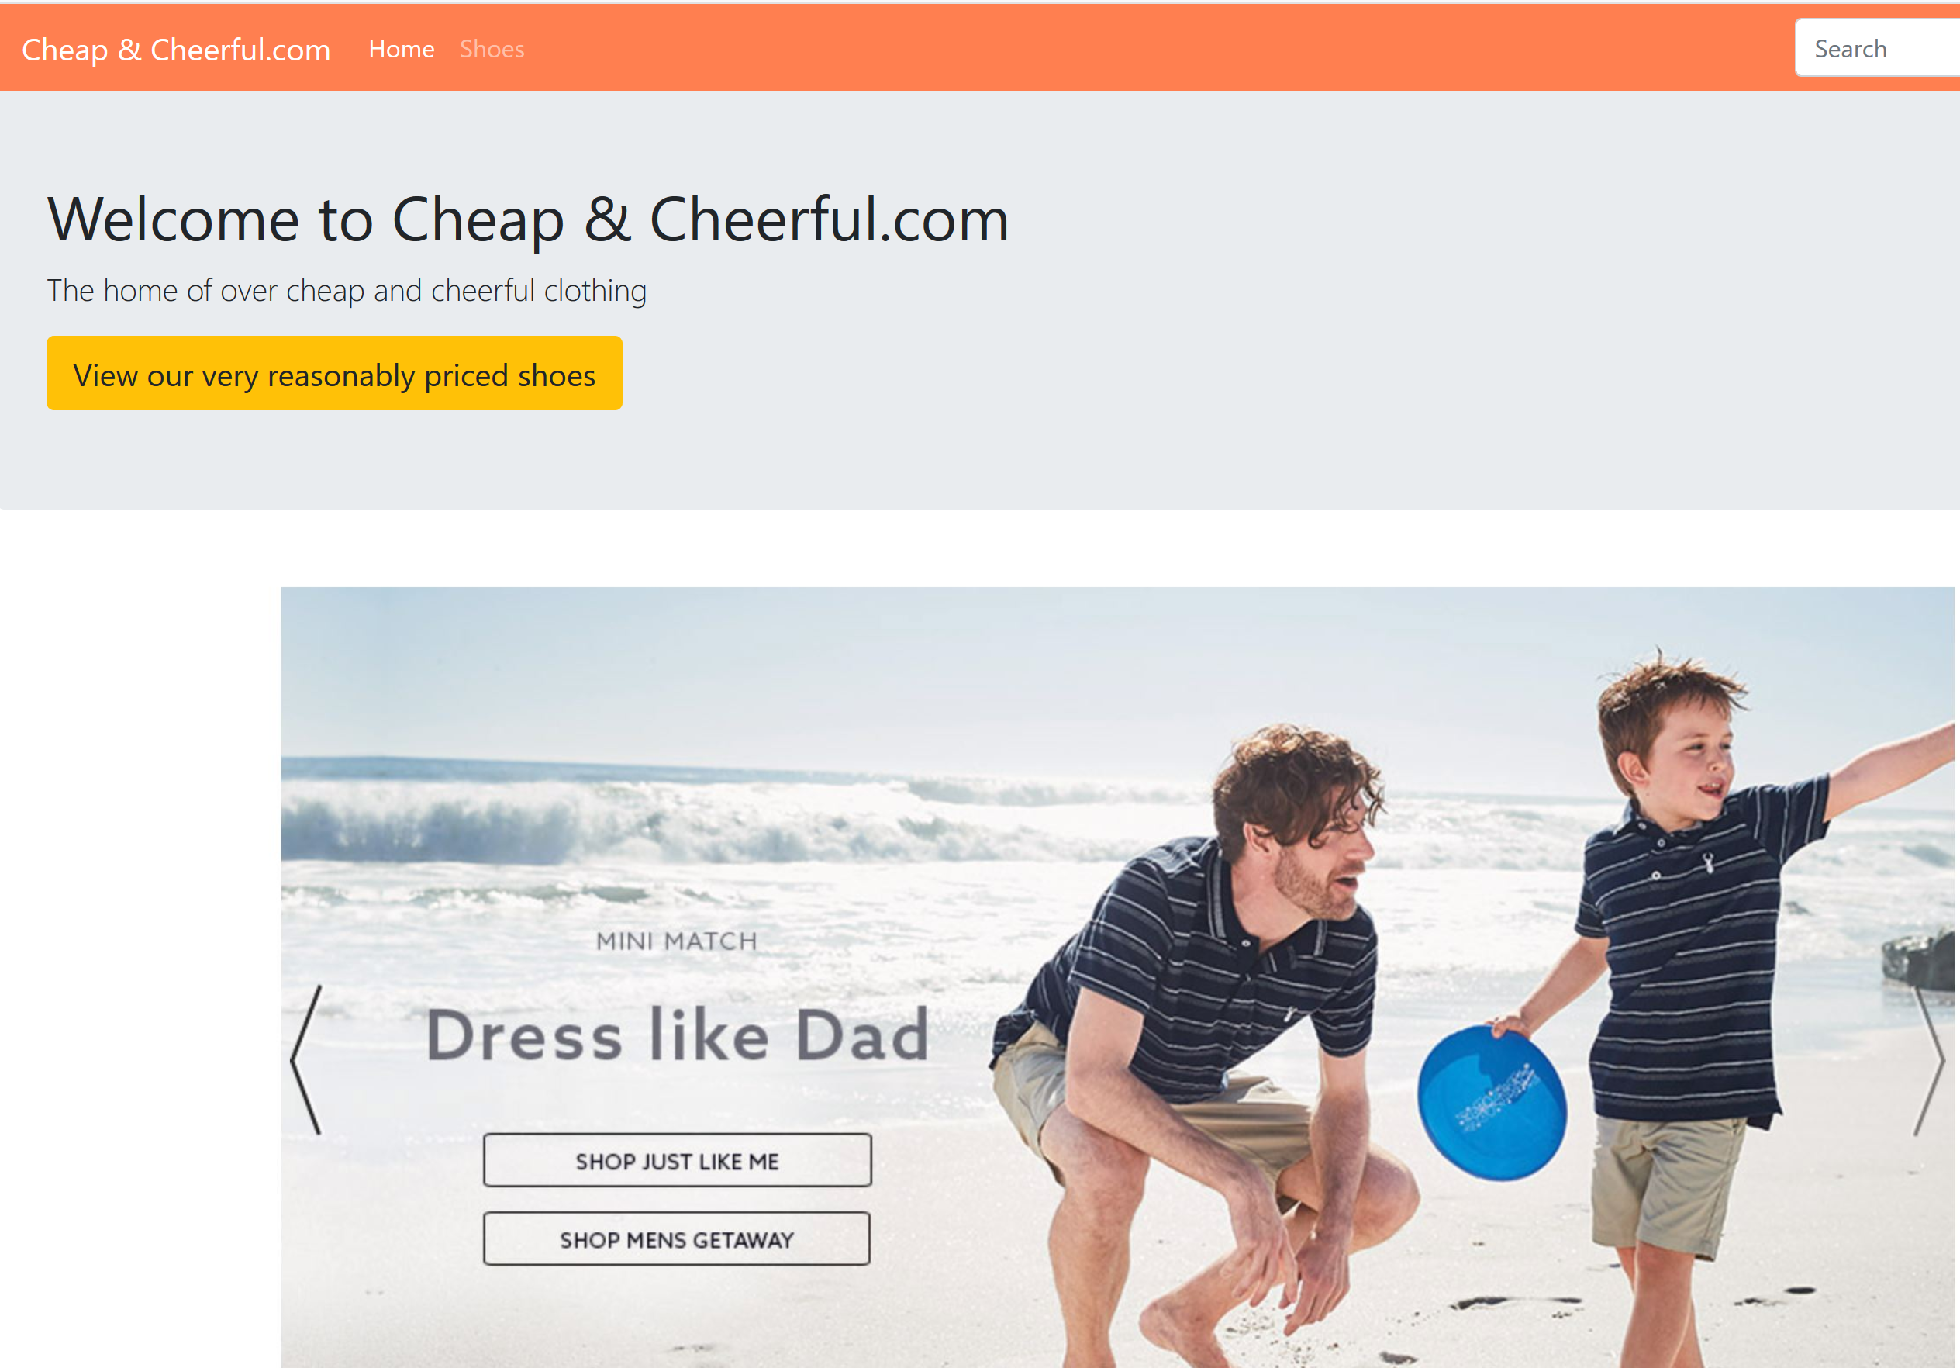
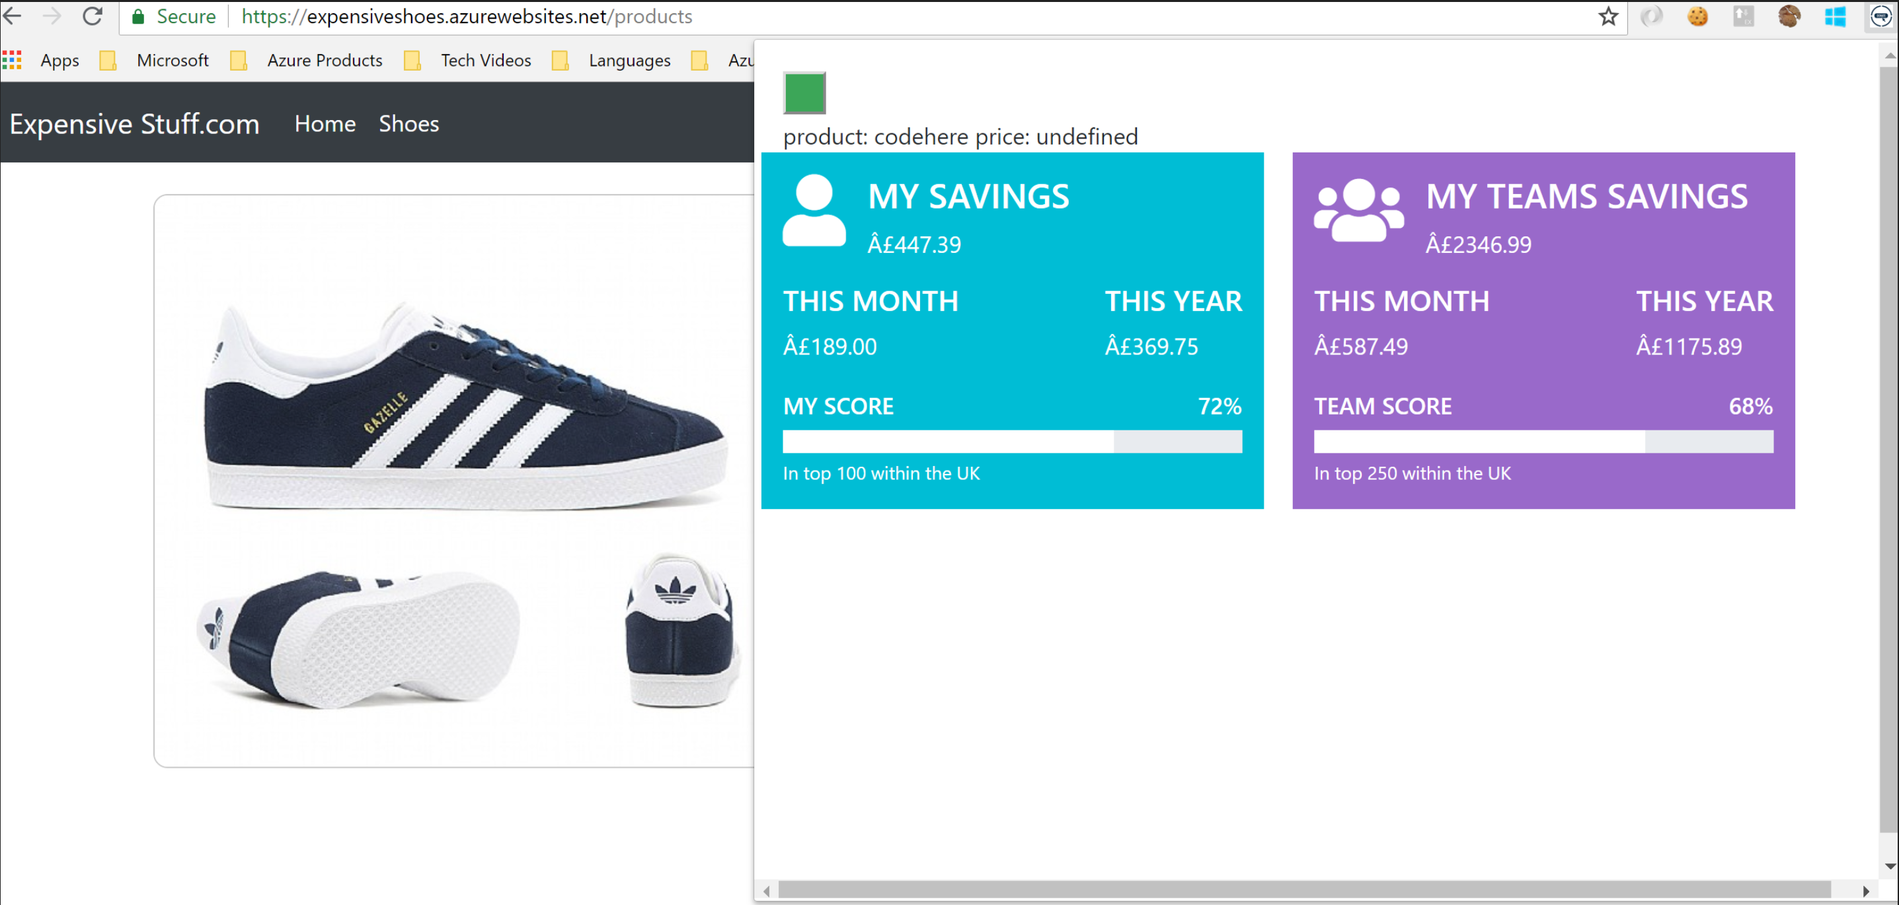
What does it look like - now?

Slide 6
How this address the asks of the hack?
Make Something: Does the project make or create something tangible that can be shown or demonstrated, going beyond an idea?
Yes
Address the Challenge: Does the project address the Challenge, and present a clear and relevant solution?
YES
Potential Value: Does the project align to business, cultural, career, or personal value?
Helps charities and makes it simple for people to donate and track donations
Feasibility: Does the project have actionable next steps and a reasonable chance of success in its implementation?
YES
AI and Ethics: Does the project adhere to the Microsoft principles for AI Technology and Designing AI for People?
AI does the compare – PricE API used
Inclusion: Does the project consider and include some of the many dimensions/facets of diversity in our world?
Yes
Keep it Simple: Does your project outcome deliver a simple, easy to understand experience for your target audience?
Yes

Slide 7
DEMO

Slide 8
Thank you from 2 many enginners

